Slide 1

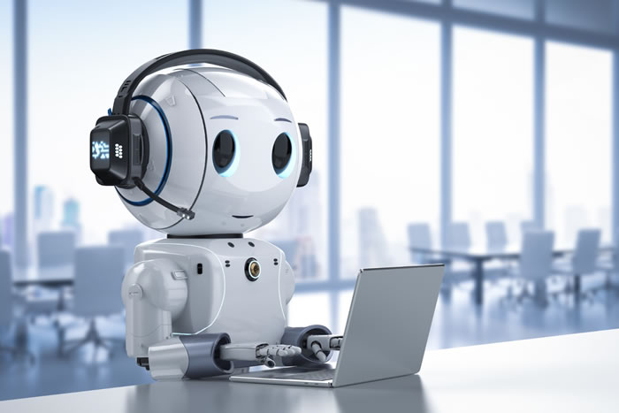
CHATBOT
AI-BASED

Slide 2

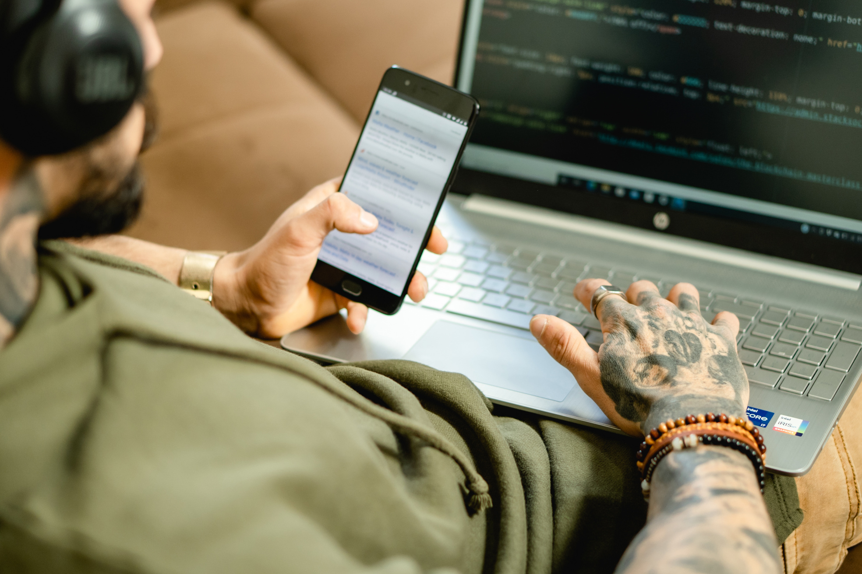
INTRODUCTION
Chatbots are AI-powered tools designed to simulate conversation with users.
This project involves building a Python-based chatbot that uses NLP to understand user inputs and reply meaningfully.
It aims to improve user interaction and automate basic support tasks.

Slide 3
PROJECT GOALS
Develop a chatbot that can engage in real-time conversations.
Use Natural Language Processing (NLP) for understanding text.
Ensure responses are relevant, fast, and context-aware.
Provide a friendly and user-centric interaction experience.

Slide 4
TOOLS AND TECHNOLOGIES
PROGRAMMING LANGUAGE: PYTHON
NLP LIBRARIES: NLTK, SPACY
DEVELOPMENT TOOLS: VISUAL STUDIO CODE, JUPYTER NOTEBOOK
FRAMEWORKS: FLASK / STREAMLIT FOR WEB DEPLOYMENT
DATASETS: CHATTERBOT CORPUS, CUSTOM INTENTS

Slide 5
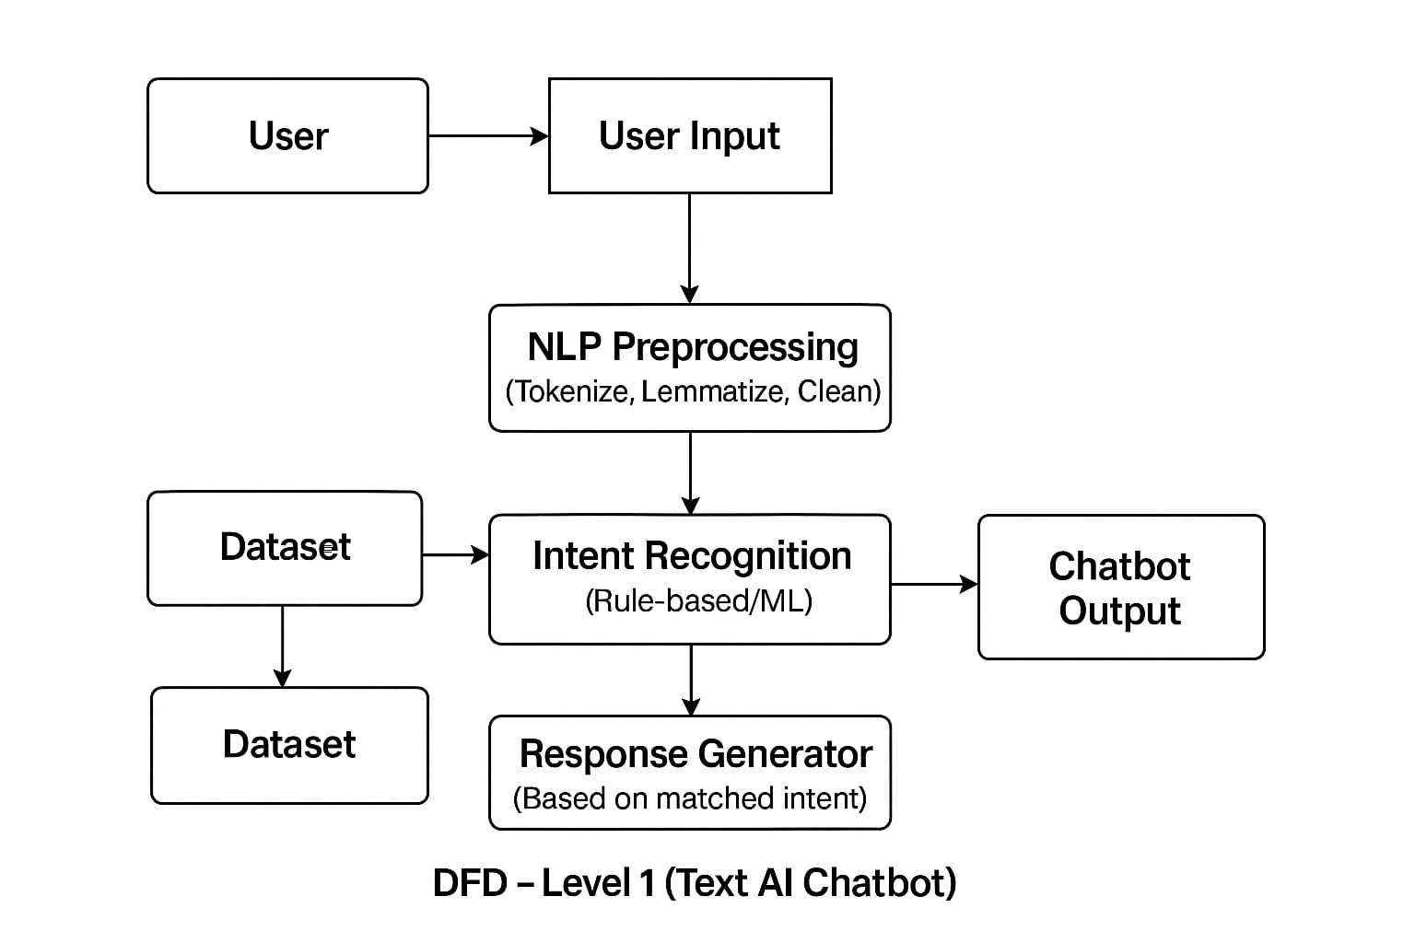
DFD

Slide 6
KEY FEATURES
Understands basic intents (greetings, help, etc.)
fast response
Modular design for easy improvement
Friendly and conversational tone
Works on both terminal and web interface

Slide 7
APPLICATIONS
Customer Support: Automate FAQs and live chat for websites
Education: Virtual tutoring or answering common student queries
Healthcare: Initial symptom checking or appointment scheduling
E-commerce: Product recommendations and order tracking
Entertainment: Fun, interactive chat and games

Slide 8
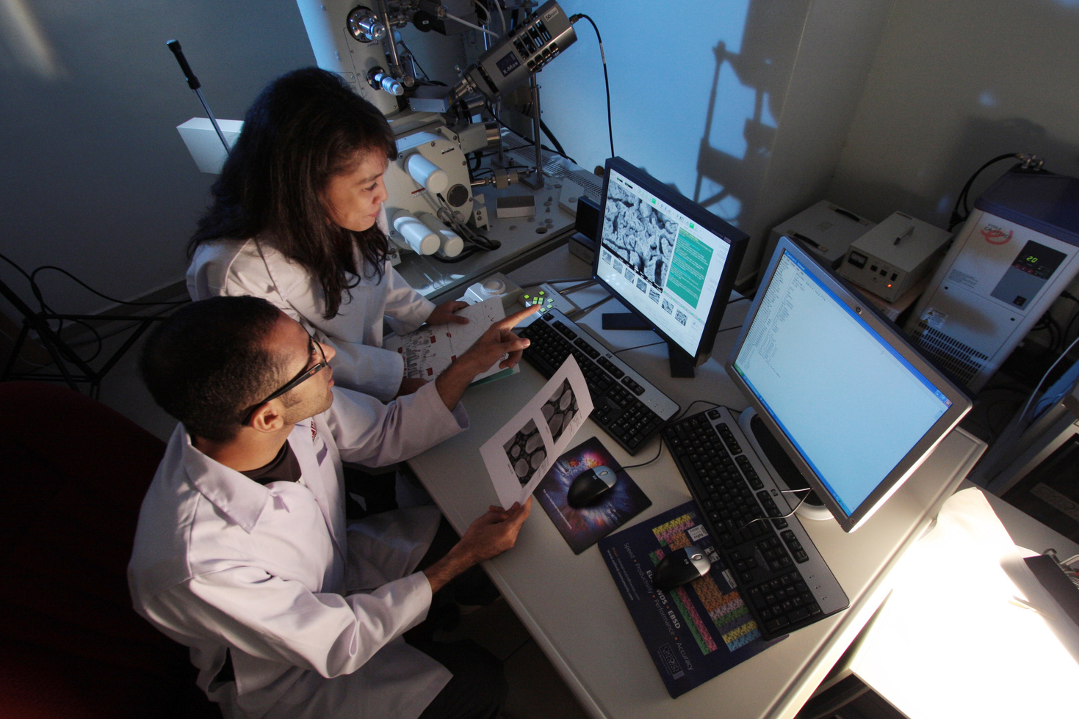
FUTURE SCOPE
Integrate deep learning models (LSTM or Transformers)
Add multilingual support
Enhance small talk and emotional understanding
Use chatbot in real domains like education or customer support

Slide 9
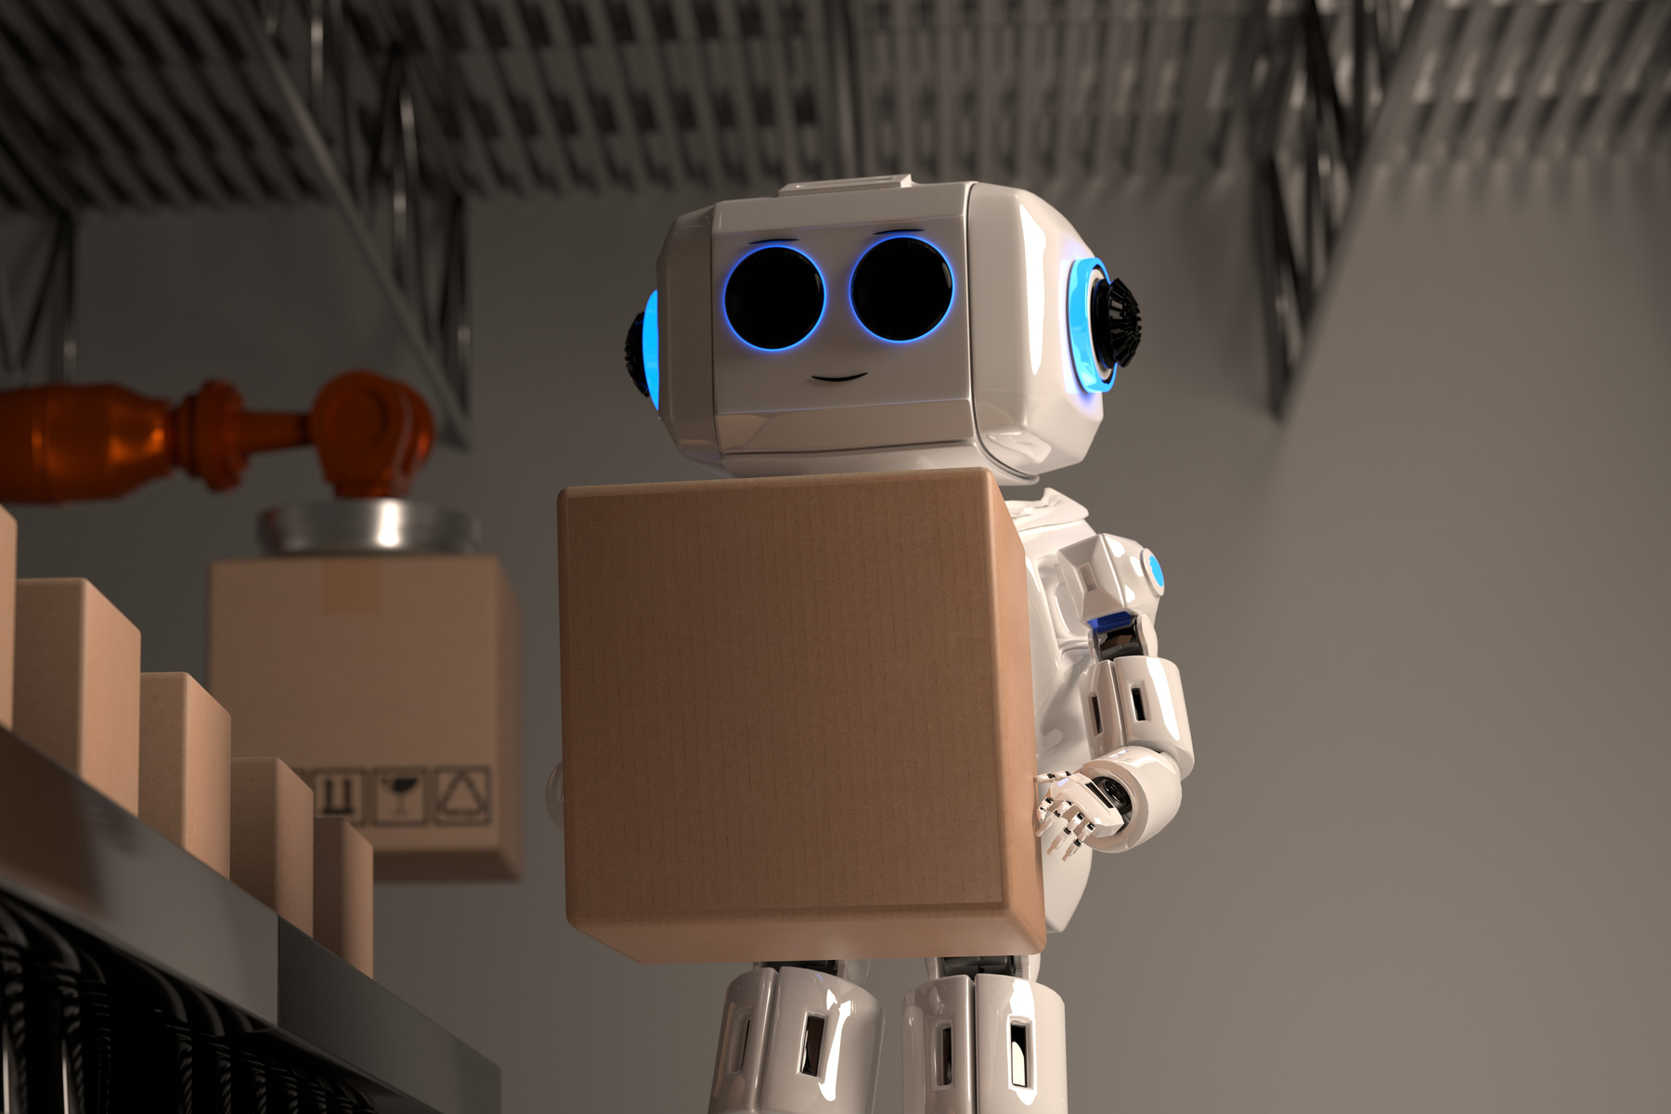
CONCLUSION
This project shows how AI and NLP can be combined to build smart assistants.
The chatbot works efficiently for basic interactions and provides a foundation for future enhancements.
It’s scalable, fast, and user-friendly.

Slide 10


THANK YOU

